Slide 1
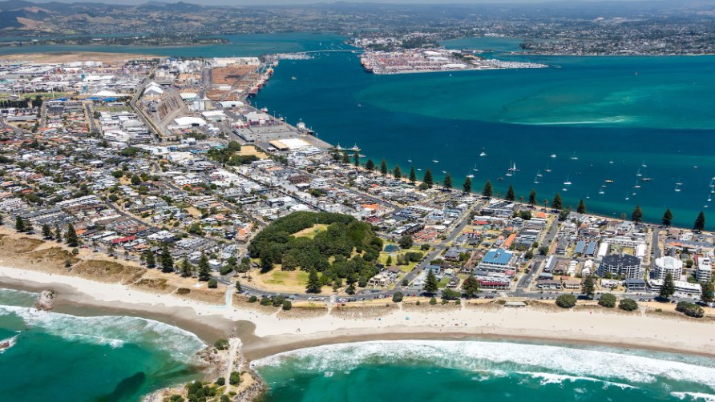

Presentation to Analysts
28 August 2026

Slide 2

Disclaimer
The information in this presentation is for information purposes and has been prepared by Port of Tauranga Limited with due care and attention. However, neither the Company, nor any of its Directors, officers, employees, contractors or agents, shall have any liability whatsoever to any person, for any loss of damage resulting from the use or reliance on this presentation.
The information contained in this presentation is not intended to be relied upon as advice to investors and does not take into account the investment objectives, financial situation or needs of any particular investor.
Past performance is not indicative of future performance, and no guarantee of future returns is implied or given.
The information contained in this presentation should be considered in conjunction with the Company's latest audited financial statements which are available in the investor section of our website.
2

Slide 3
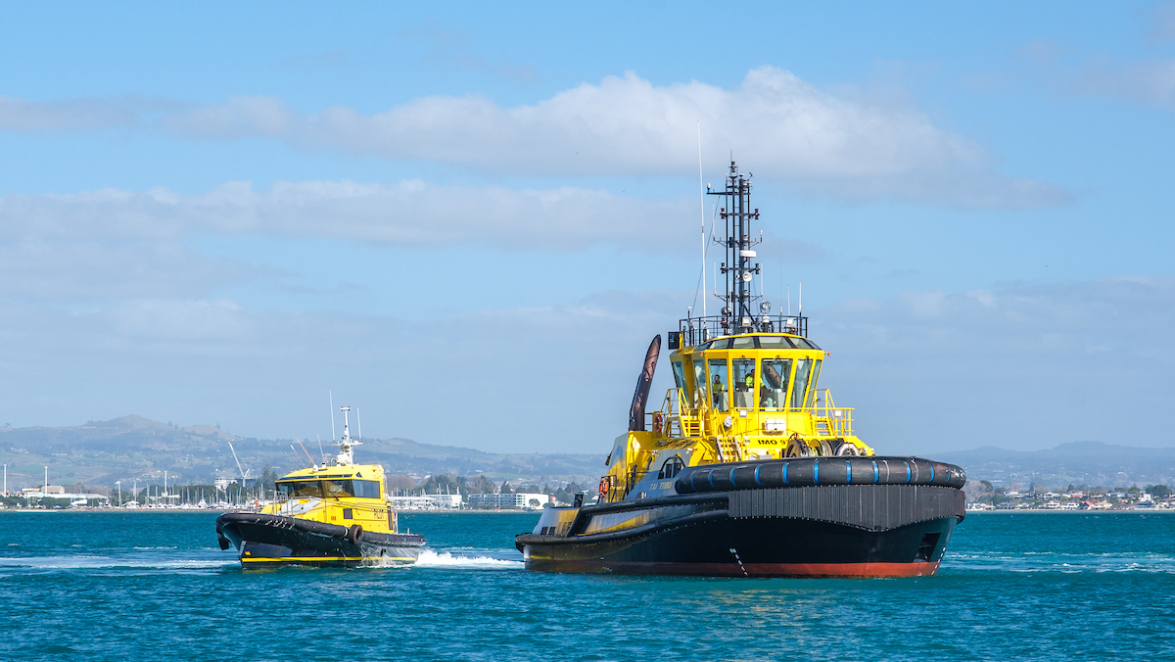

Highlights
Julia Hoare
Chair
3

Slide 4
For the year ended 30 June 2026
Group underlying earnings¹ up 23.2%
Highlights
$000s
$155,314
Record underlying Group net profit after tax.
$126,036
Result driven by revenue uplift and cost savings.
$112,357
$117,792
$102,290
Strong contributions from Parent and Group companies.
Trade volumes flat.
FY22
FY23
FY24
FY25
FY26
¹ Underlying earnings is a non-GAAP financial measure which excludes items considered to be one-off and not related to core business such as changes to tax legislation and impairment of assets.
6

Slide 5
For the year ended 30 June 2026
Group reported net profit after tax down 10.0%
Highlights
$000s
$173,373
Group reported profit decreased by $17.3 million compared to the prior year.
$156,052
Prior year reported profit included a one-off gain of $49.2 million from the sale of Northport.
$111,317
$117,136
$90,849
FY22
FY23
FY24
FY25
FY26
4

Slide 6
For the year ended 30 June 2026
Group underlying earnings bridge
$000s
Total
Increase
Decrease
One-off items
A one-off deferred tax benefit of $1.5 million was recognised following the reclassification of the Gateside and Rolleston properties as Assets Held for Sale and the resulting reassessment of deferred tax.
156,052
(1,534)
796
155,314
Estimated costs to sell of $0.8 million, including legal and agency fees, were recognised through profit or loss in accordance with IFRS 5.
Group reported NPAT
Deferred tax adjustment on properties held for sale
Impairment of held for sale assets (net of tax)
Group underlying earnings
5

Slide 7
Stronger earnings underpins dividend growth
Full year dividend increased 22.8%
Final dividend
Cents per share
Interim dividend
Final dividend
12.5 cents per share fully imputed.
20.5
Record date: 18 September 2026.
12.5
Payment date: 2 October 2026.
16.7
14.7
15.6
14.7
9.7
Port of Tauranga (POTL) full year ordinary dividend payout ratio at 90% of full year underlying earnings.
8.2
8.8
8.7
8.0
6.5
6.8
6.0
7.0
FY22
FY23
FY24
FY25
FY26
7

Slide 8
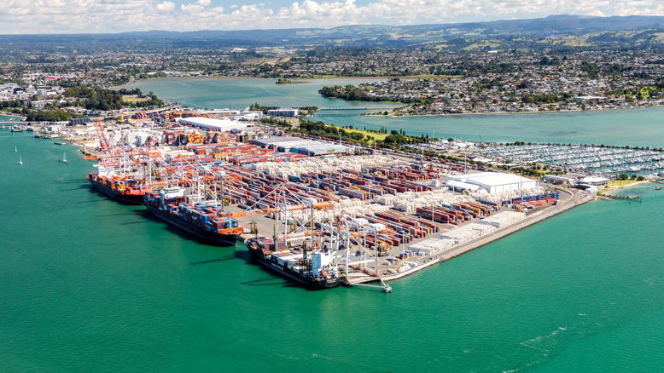
Full year overview & trade commentary
Leonard Sampson
CEO
8

Slide 9
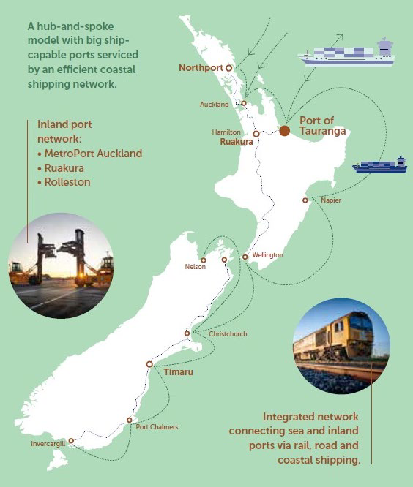
FY 2026 overview
Strategic milestones
Stage 2 capital dredging – commenced and running to plan with completion expected in March 2027.
Fast-track draft decision – received August 2026 recommending award of consent.
Our blueprint for growth
Service delivery improvement – crane and ship productivity increased 9.9% and 13% respectively.
Yield and cost recovery initiatives – successfully implemented enhancing efficiency and improving return.
MetroPort – new model successfully embedded with focus on service delivery and operational efficiency.
Subsidiary and joint ventures – improved business performance.
Northport Group – successful integration of the Marsden Maritime Holdings (MMH) and Northport businesses. New CEO appointed 1 July 2026.
Automation – emulation digital twin implemented, Automated Stacking Crane (ASC) hybrid terminal proof of concept.
9

Slide 10
For the year ended 30 June 2026
Total trade decreased 3%
Bulk export commodities impacted by Iran conflict and fuel cost escalation.
tonnes (millions)
24.7
25.3
24.6
23.6
Hydro storage levels higher than prior year resulting in lower import coal demand.
Container berth capacity constraints impact transhipment.
Diversity of cargoes support resilience of trade.
FY23
FY24
FY25
FY26
10

Slide 11
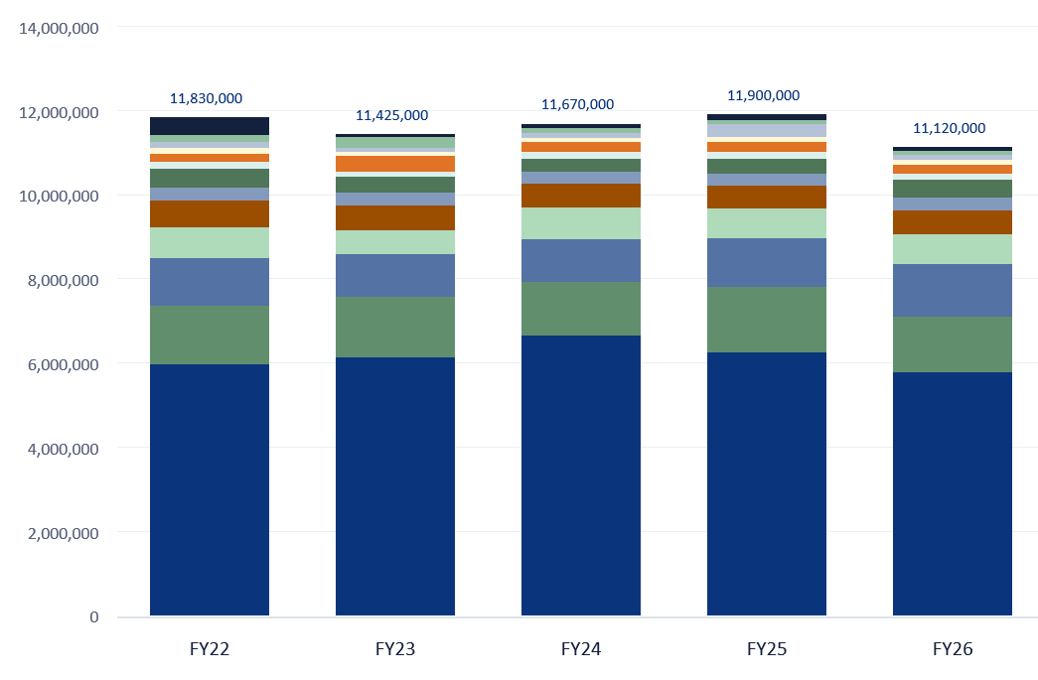
For the year ended 30 June 2026
Bulk volumes decreased 5.9%
Tonnes
Export logs
Import coal
5.8m tonnes
143,000 tonnes
Export log volumes 5.8 million tonnes vs 6.3 million prior year
Import coal 143,000 tonnes vs 405,000 prior year
Proteins and stock feed
Fertiliser imports
1.3m tonnes
372,000 tonnes
Proteins and stock feed imports up 0.6%
Fertiliser imports up 1.2% on prior year
11

Slide 12
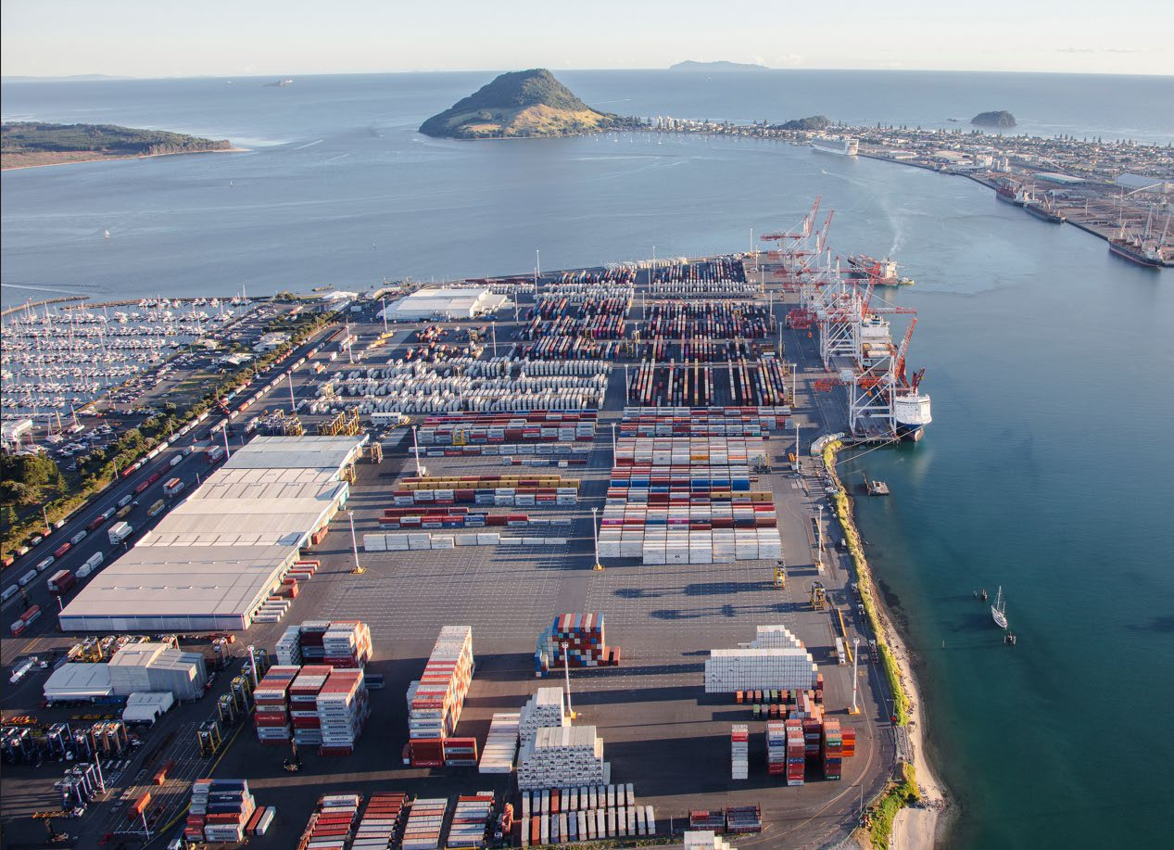
For the year ended 30 June 2026
Total container volumes increased 0.4%
Berth capacity constraints impact further container growth.
TEU's
1,177,350
1,208,252
1,213,494
1,147,350
FY23
FY24
FY25
FY26
12

Slide 13
For the year ended 30 June 2026
Container trends
Export volumes increased 2.4%
Import volumes increased 2.5%
Transhipment volumes decreased 5.5%
TEU's
TEU's
TEU's
486,702
484,107
500,735
512,765
404,285
384,145
401,415
411,340
286,363
279,098
306,102
289,389
FY23
FY24
FY25
FY26
FY23
FY24
FY25
FY26
FY23
FY24
FY25
FY26
Robust second half export season with strong refrigerated container volumes.
Import growth reflects demand to both MetroPort and Ruakura.
Transhipment impacted by berth capacity constraints and service changes.
13

Slide 14
For the year ended 30 June 2026
MetroPort rail container volume increased 5.4%
New MetroPort model successfully implemented 1 December 2025.
TEU's
Export
Import
Port of Tauranga continues to manage end-to-end service delivery through to shipping lines.
184,174
159,653
154,233
KiwiRail are able optimise rail and container transfer operations across broader network, supporting further volume growth.
134,727
140,263
131,291
118,042
110,752
114,566
100,373
97,982
105,477
Core train programme currently 78 trains per week.
New model supports strategic alignment for future growth.
FY21
FY22
FY23
FY24
FY25
FY26
Excludes Ruakura Inland Port volume
14

Slide 15
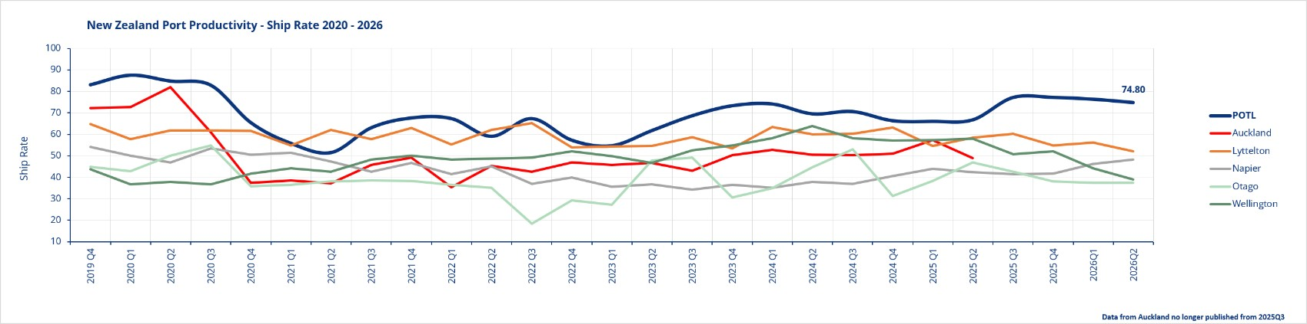
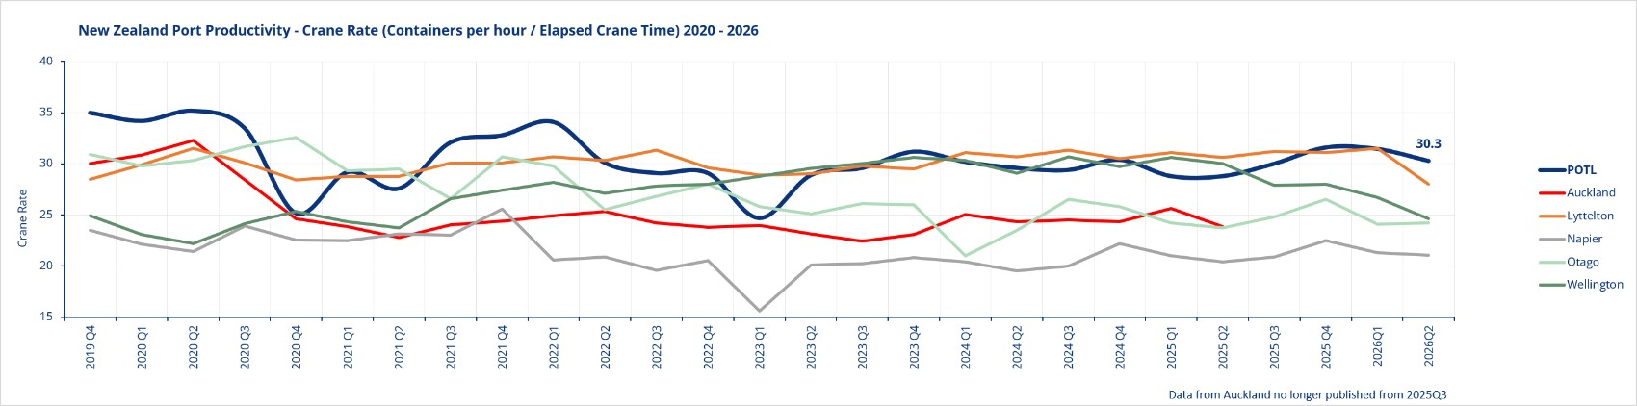
For the year ended 30 June 2026
New Zealand port productivity
Crane rate increased 9.9% vs prior year.
Ship rate increased 13% vs prior year.
Direct corelation between improving on-time vessel arrival and port productivity.
NZ port productivity issues are amplified at Tauranga, as final call on the majority shipping services.
15

Slide 16
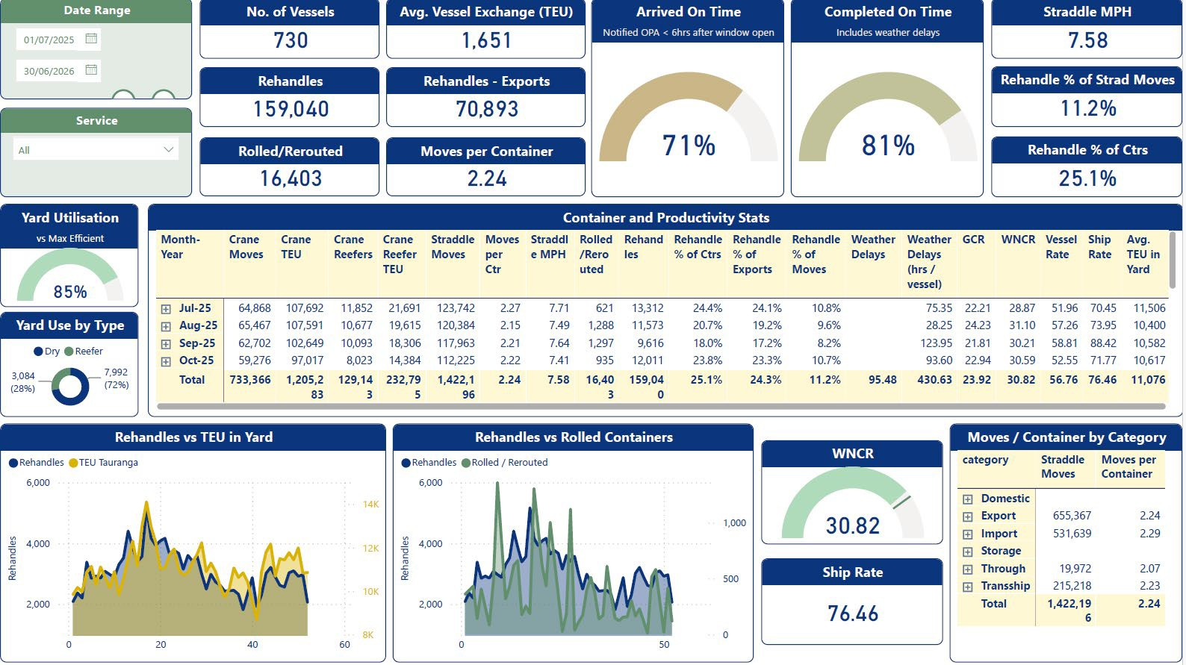
For the year ended 30 June 2026
Service delivery and productivity
On-time vessel arrival for FY26 71% vs 62% prior year.
New dwell and rolled container incentives significantly reduced yard congestion.
Yard congestion improved 9% to 11,069 TEU.
Emulation work to develop yard strategies targeting rehandle reduction.
16

Slide 17
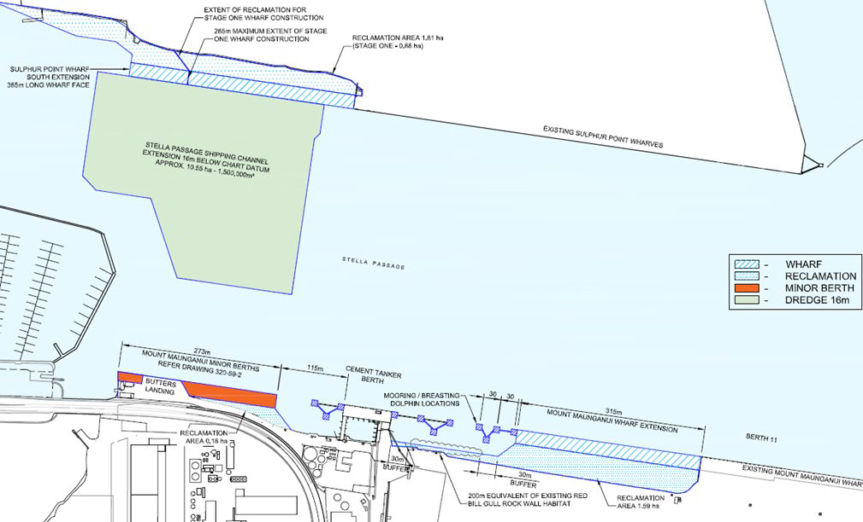
Update August 2026
Stella Passage resource consent
New Fast-track application lodged January 2026.
EPA completeness decision received February 2026.
Panel appointment March 2026.
Panel commencement and evaluation commenced April 2026.
Panel draft decision received 17 August 2026 recommending consent to be granted.
Final decision due 7 September 2026.
17

Slide 18
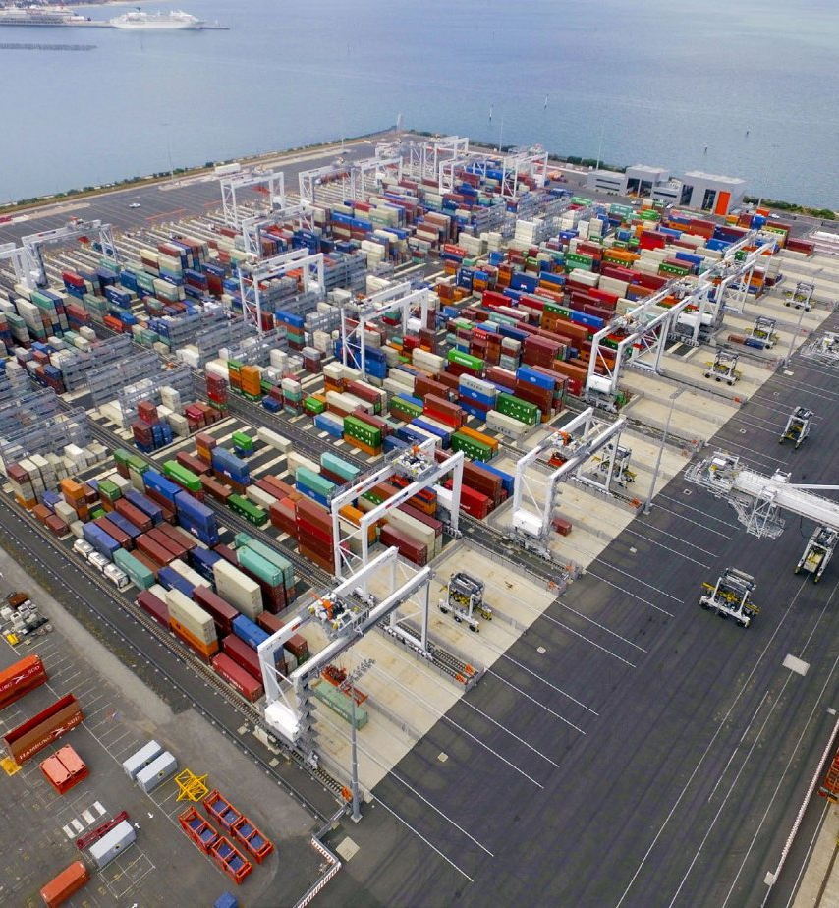
Port of Tauranga - Terminal automation project
Automated Stacking Cranes (ASCs)
Progress update
Final-form contract nearing completion.
ASC emulation software has been implemented at the Tauranga Container Terminal to test ASC technology virtually.
Proof of concept for Hybrid terminal operation milestone achieved
through emulation testing.
Deployment of ASCs linked to timing of berth extension.
Staged bolt-on introduction of ASCs relative to volume growth requirements. Implementation planned over four phases (nine ASC blocks).
Stage one (two ASC blocks) cost circa ~ $100 million.
Fully electric ASCs ~75% reduction in emissions relative to a traditional straddle operation.
18

Slide 19
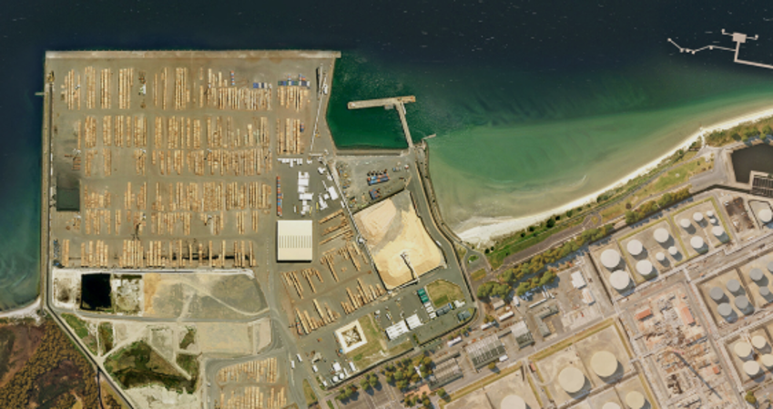
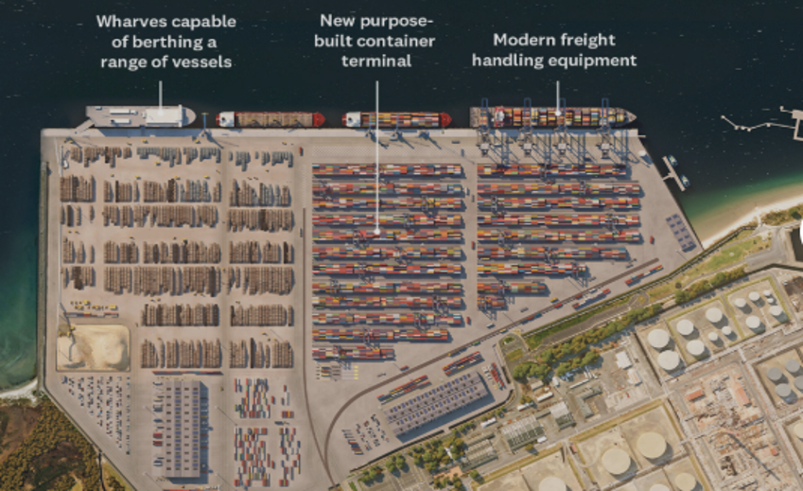
Northport Group
Northport Group established July 2025.
Current
Northport's Vision for Growth resource consent granted October 2025.
Government commitment to roading infrastructure investments improving connectivity to Northport.
Marsden rail spur currently under detailed engineering and cost evaluation by KiwiRail. KiwiRail has selected Acciona, Downer/HEB and Martinus Rail to compete on lower-cost design options before Government funding decision.
Future – now consented
Berth 3 container terminal extension linked to timing of rail spur.
New Northport Group Chief Executive, Rhys Jones, commenced 1 July 2026.
19

Slide 20

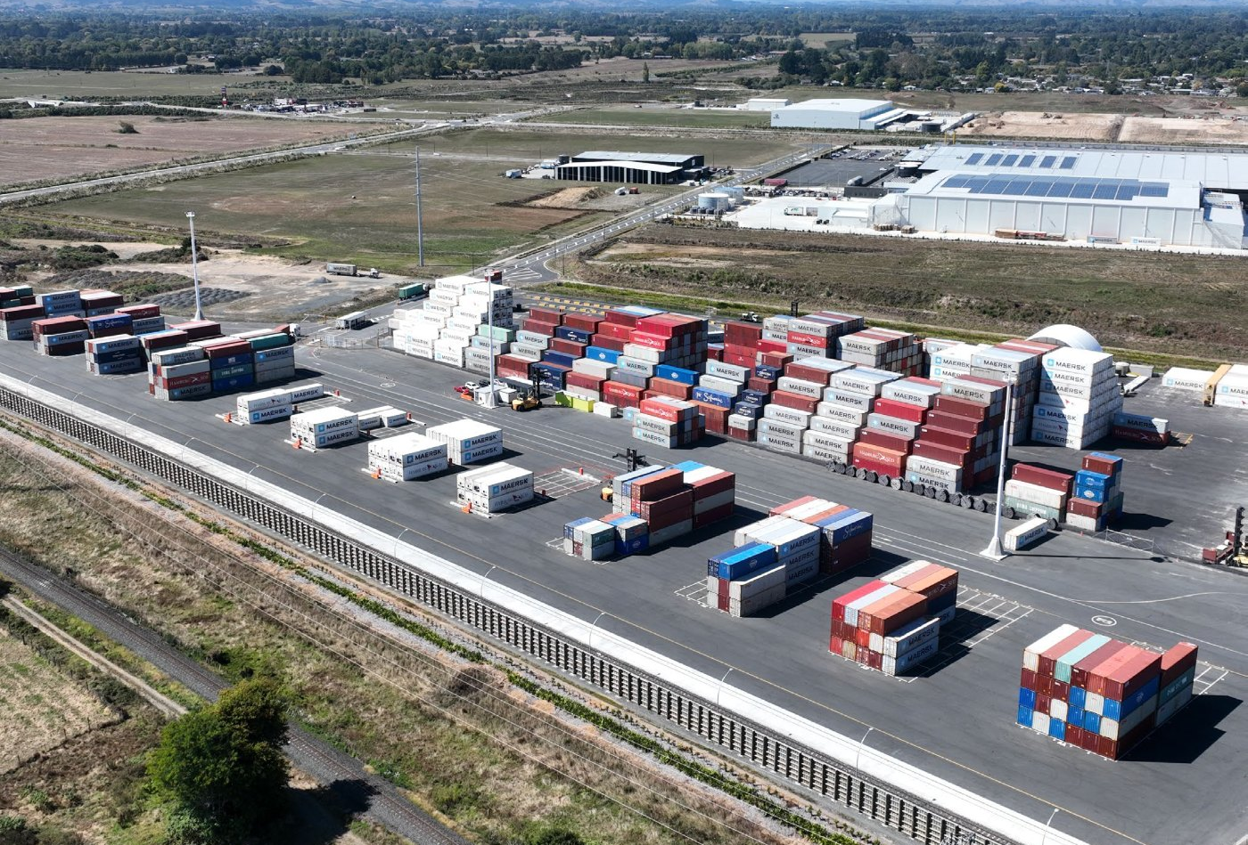
Ruakura Inland Port
Ruakura Inland Port (RIP) profit of $0.354 million for the year, up from $0.132 million in FY2025.
RIP handled 24,067 TEU for the year, up 6.8% from 22,525 TEU in FY205.
Tainui and Brookfield joint venture will aid development and support inland port customer container growth.
20

Slide 21
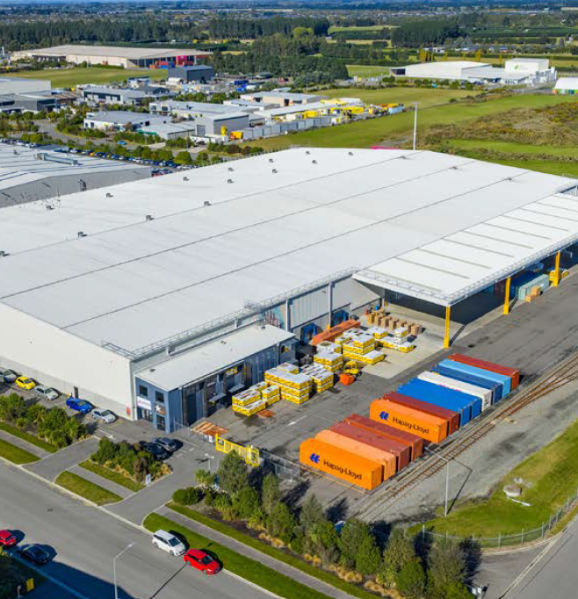
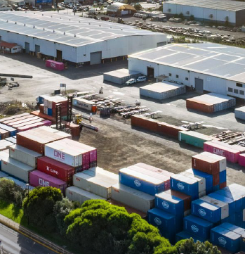
Funding the growth programme
Capital recycling
Proceeds from non-strategic property sales will be redeployed into priority infrastructure projects, including Stella Passage, automation and dredging.
Properties in South Auckland and Rolleston near Christchurch are on the market as part of a capital recycling strategy.
Premium logistics assets expected to attract strong investor interest.
Held for sale assets valued at ~ $148 million
Rolleston, Christchurch
South Auckland
21
Notes:
Non-strategic property sales fund Stella Passage, automation and dredging.

Slide 22

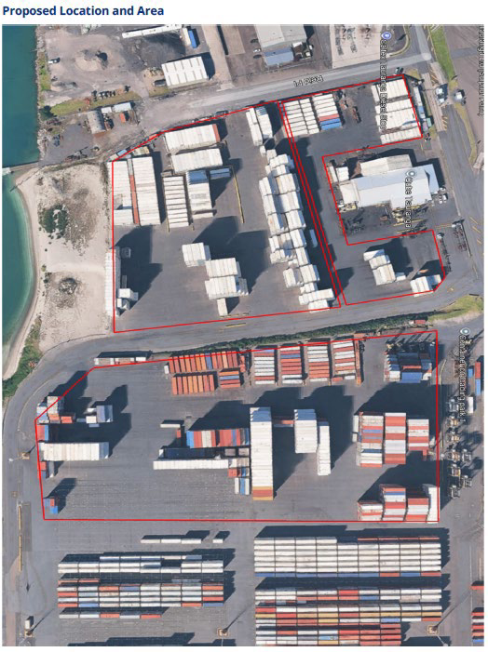
Sulphur Point
New empty link facility being established at Sulphur Point
Establishing an empty-container facility connected directly to Tauranga Container Terminal and operated by QM Logistics.
Taking back land from existing depot operators.
Enables surplus export empties to move directly to the Port, avoiding unnecessary transit through an external depot.
Import empties can be stacked and released efficiently using empty handling equipment.
Expected terminal operational benefits include:
reduced empty-container dwell and handling;
reduced terminal truck and rail congestion; and
greater control and flexibility as the terminal develops.
Targeted commencement date 1 November 2026.
22

Slide 23
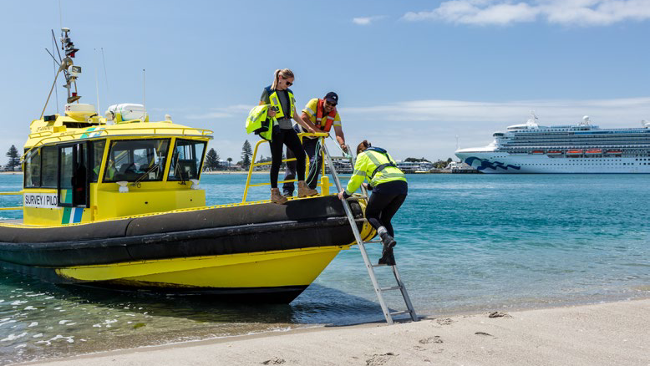
Financial results
Simon Kebbell
CFO
23

Slide 24
Strong revenue growth of 4.7% and operating costs down 6.2%
Group reported profit down 10.0%
Strong operating revenue growth delivered across all operating units. Revenue growth was impacted by the MetroPort model change, which removed rail income from reported revenue.
30 June ($000s)
2026
2025
Variance
Operating revenue
486,469
464,675
21,794
Operating costs decreased by $14.5 million (6.2%), due to the change in the MetroPort model.
Operating costs
(221,737)
(236,276)
14,539
Results from operating activities
264,732
228,399
36,333
Depreciation and amortisation up $3.3 million (7.6%), mainly due to higher building depreciation, including increased depreciation on the terminal sheds scheduled for removal.
Depreciation and amortisation
(46,180)
(42,925)
(3,255)
Impairment of assets
(1,105)
(2,534)
1,429
Net finance costs down 13.0% reflecting lower wholesale interest rates and increased interest income on loans to Equity Accounted Investees (EAIs).
Net finance costs
(17,242)
(19,814)
2,572
Share of profit from Equity Accounted Investees (EAIs)
10,974
6,189
4,785
Strong contribution from EAIs with earnings up $4.8 million (77.3%).
Gain on disposal of EAIs
0
49,161
(49,161)
Profit before income tax
211,179
218,476
(7,297)
Income tax expense
(55,127)
(45,103)
(10,024)
Profit for the period
156,052
173,373
(17,321)
24

Slide 25
Increase reflects pricing initiatives and operating efficiencies
Results from operating activities up 15.9%
Operating revenue up $21.8 million driven by Parent tariff increases, higher infrastructure charges, a Mount Maunganui access charge, and strong growth in rental and marine income, with only modest volume increases across terminal volumes and a decrease in bulk cargo. Rail revenue ceased 1 December 2025.
$000s
Increase
Decrease
Total
26,570
(6,851)
Contracted services for port operations costs decreased 28.4% reflecting terminal productivity initiatives and the new MetroPort model removing direct rail costs from 1 December 2025.
(1,379)
(2,007)
(1,794)
264,732
298
4,145
436
Employee expenses up 10.6% reflecting additional staff numbers and wage increases. Increasing head count at both Parent and subsidiaries supporting future growth initiatives.
6,411
10,504
228,399
Maintenance of property, plant and equipment increased by 9.6%, driven by the timing of the Tai Pari main engine overhaul, five-year surveys of the Sir Robert and Tai Timu and increased straddle maintenance.
FY25
Container terminal revenue
Multi-cargo revenue
Marine services revenue
Property revenue
Other revenue
Contracted services for port operations
Employee benefit expenses
Direct fuel and power
Maintenance of pp&e
Other expenses
FY26
25

Slide 26
Strong performance at the parent level and group companies
Parent underlying earnings up 21.4%
Parent company profit increased 21.4% compared with the prior corresponding period.
000s
Parent
Subsidiaries and EAIs
$15,488
Subsidiaries and Equity Accounted Investees delivered a 42.1% profit uplift, reflecting strong performance across the portfolio.
$10,899
$13,912
$14,003
$139,826
$10,435
$115,137
$97,405
$103,789
$92,283
FY22
FY23
FY24
FY25
FY26
26

Slide 27
Strong performance from Group companies with profits up 42.1%
Subsidiary and joint venture companies
FY26
$000
FY25
$000
Movement $000
Northport Group profit reflects strong trade and synergy gains. The revised capital structure resulted in shareholder loans. The Parent recognised $2.0 million ($0 FY25) of interest income on these loans from Northport Group during the period.
Quality Marshalling
3,690
3,429
261
Timaru Container Terminal
1,331
578
753
PrimePort Timaru
2,484
1,464
1,020
Coda Group losses stemmed with the sale of 3PL and Rolleston distribution centre segments.
Northport Group
7,533
7,055
478
PortConnect
229
150
79
Coda
(133)
(1,909)
1,776
Ruakura Inland Port
354
132
222
Reported net profit after tax
15,488
10,899
4,589
27

Slide 28
Strong cash generation from operating activities
Cashflow from operations up 19.4%
30 June ($000)
2026
2025
Variance
Net operating cash inflow increased by $33.4 million (19.4%) reflecting stronger profitability.
Net cash inflow from operating activities
205,428
171,981
33,447
Capex accelerated in the second half due to capital dredging and major plant and equipment purchases.
Capital expenditure
(86,718)
(29,533)
(57,185)
Free cashflow
118,710
142,448
(23,738)
28

Slide 29
Parent Capital expenditure investment 2021 - 2026
Group capex $86.0 million for the period.
$000s
Capex
MMH
Ruakura Inland Port
FY26 Parent capital expenditure of $81.5 million
Major projects underway include:
10,106
Capital dredging ($70-90 million)
21,450
Hybrid tug ($27 million)
Purchase of seven new straddles - one electric and six hybrid ($18 million).
39,689
2,135
81,542
2,850
44,322
34,691
23,796
18,612
27,221
FY21
FY22
FY24
FY24
FY25
FY26
29

Slide 30
Net debt / net debt + equity
Net debt / net debt + equity
Leverage remains low, providing balance sheet headroom to progress capital dredging, berth extension, Northport development and automation project.
17.3%
17.2%
16.9%
16.8%
16.4%
FY22
FY23
FY24
FY25
FY26
30

Slide 31
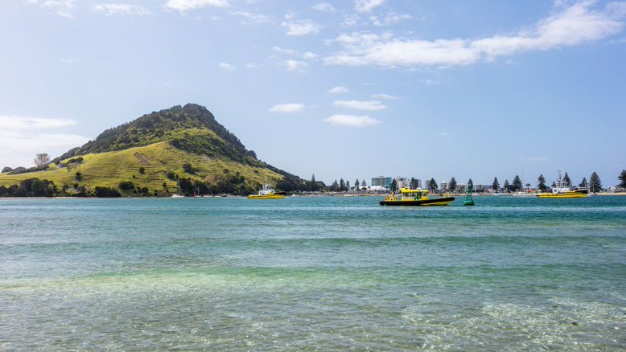
Outlook and guidance
31

Slide 32
Outlook 2027
Another strong export peak season expected in FY2027 with key commodities dairy, red meat and kiwifruit. Logs to remain subdued.
Full year underlying earnings expected to be in the range of
Productivity initiatives, cost control and yield improvement remain a priority.
$160m– $175m
New MetroPort model working well with increased terminal rail volumes and no impact on service levels.
Terminal berth capacity constraints remain a key challenge.
Stella Passage resource consent decision anticipated on 7 September 2026.
Underlying earnings is a non-GAAP financial measure which excludes items considered to be one-off and not related to core business such as changes to tax legislation and impairment of assets.
New TerminalConnect empty link facility go live in November 2026.
32

Slide 33
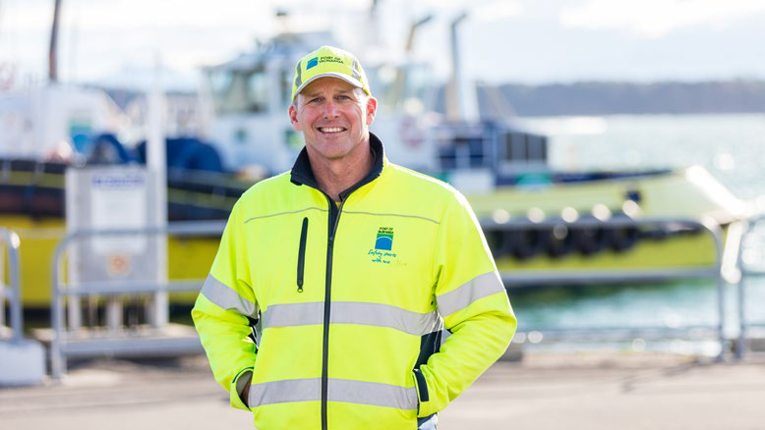
Questions
33

Slide 34
Thank you
47

Slide 35
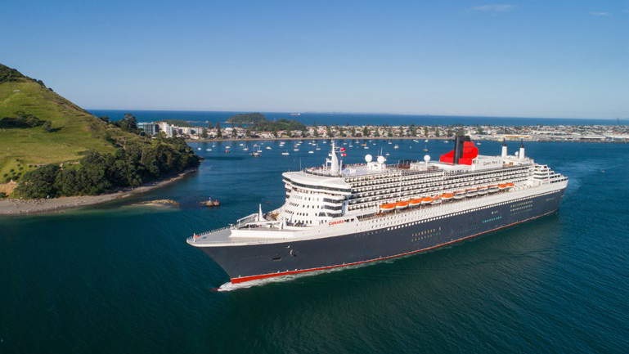
Appendices
34

Slide 36
Financial details and trade forecasts
34

Slide 37
For the year ended 30 June 2026
Results from operating activities
2026
$000
2025
$000
Movement
$000
2026
$000
2025
$000
Movement
$000
Operating Revenue
Operating Costs
Container terminal - ship exchange and sundry
229,764
194,174
35,590
Contracted services for port operations
* (67,082)
(93,652)
26,570
Container terminal - reefer
29,762
30,234
(472)
Employee benefit expenses
(71,186)
(64,335)
(6,851)
Container terminal - storage
13,252
15,895
(2,643)
Direct fuel and power
(21,543)
(20,164)
(1,379)
Container terminal - rail
* 22,482
44,453
(21,971)
Maintenance of property, plant and equipment
(22,872)
(20,865)
(2,007)
Multi-cargo
84,465
78,054
6,411
Marine services
54,483
54,185
298
Other
(39,054)
(37,260)
(1,794)
Property
51,281
47,136
4,145
Total Operating Costs
(221,737)
(236,276)
14,539
Other
980
544
436
Results from Operating Activities
264,732
228,399
36,333
Total Operating Revenue
486,469
464,675
21,794
* Revenue and costs impacted by change in MetroPort model from 1 December 2025.
35

Slide 38
For the year ended 30 June 2026
Operating costs
Contracted services for port operations
2026 $000
2025 $000
Movement
$000
Other Costs
2026 $000
2025 $000
Movement
$000
Container Terminal Labour
44,763
43,348
1,415
Rates
6,906
6,263
643
Rail costs
* 22,291
48,979
(26,688)
Insurance
6,967
8,453
(1,486)
Reefer Monitoring
* 24
1,056
(1,032)
IT
9,002
6,822
2,180
Other
4
269
(265)
Other
16,179
15,722
457
Total
67,082
93,652
(26,570)
Total
39,054
37,260
1,794
Maintenance of property, plant and equipment
2026 $000
2025 $000
Movement
$000
* Costs impacted by change in MetroPort model from 1 December 2025.
Crane Maintenance
2,773
3,788
(1,015)
Straddle Maintenance
5,523
4,998
525
Vessel Maintenance
5,096
2,704
2,392
Property
7,787
7,993
(206)
Other
1,693
1,382
311
Total
22,872
20,865
2,007
36

Slide 39
For the year ended 30 June 2026
Group Underlying Earnings reconciliation
2026
$000
2025
$000
2024
$000
2023
$000
2022 $000
Profit after taxation - reported
156,052
173,373
90,849
117,136
111,317
Asset impairment
1,105
2,534
28
0
1,445
Reversal of previous revaluation deficit
0
0
(622)
0
0
Gain on sale of MetroBox Limited, recorded within share of profit from Equity Accounted Investees
0
0
0
(7,215)
0
Impairment of investment in Equity Accounted Investees
0
0
0
7,871
0
Gain on disposal of Equity Accounted Investee
0
(49,245)
0
0
0
Hedging reserve reclassified to profit or loss on disposal of Equity Accounted Investee
0
84
0
0
0
Adjustments before taxation
1,105
(46,627)
(594)
656
1,445
Tax impact in relation to adjustments
(309)
(710)
166
0
(405)
Deferred tax adjustment arising from reclassification of properties as Held for Sale
(1,534)
0
0
0
0
Change in tax treatment of commercial buildings
0
0
11,869
0
0
Adjustments after taxation
(738)
(47,337)
11,441
656
1,040
Underlying Earnings
155,314
126,036
102,290
117,792
112,357
Underlying earnings is a non-GAAP financial measure which excludes items considered to be one-off and not related to core business such as changes to tax legislation and impairment of assets.
37

Slide 40
For the year ended 30 June 2026
Log exports decreased 8.1%
Key exporters have reduced operations to four-day weeks as elevated fuel costs continue to pressure margins.
log volume - JASm³
6,681,899
Lower harvesting and processing volumes are placing pressure on primary sector businesses and support services.
6,215,623
6,289,678
5,779,287
A-Grade Wharf Gate prices remain 5-10% above prior year levels.
Chinese log demand is stabilising, supported by steady inventory and consumption trends.
Strong domestic construction activity supports increased sales of sawn timber products.
Log export volumes are forecast to remain broadly flat at approximately 5.8 million tonnes next year.
FY23
FY24
FY25
FY26
38

Slide 41
For the year ended 30 June 2026
Export kiwifruit volume increased 8.5%
Forecast crop of around 220 to 225 million trays, with returns for all fruit types expected to be similar to the 2025/2026 season.
tonnes (000's)
754,372
695,589
Strong export throughput requirements for port and supply chain infrastructure.
533,656
492,002
Robust global demand for premium fruit, particularly in Europe, North America, Japan and Korea.
Oversupply of premium fruit types is China creating pricing and competitive market pressure.
Fruit quality confidence and market diversification remain priorities through the second half of season.
FY23
FY24
FY25
FY26
39

Slide 42
For the year ended 30 June 2026
Export dairy volume increased 0.9%
Strong start to FY2027, with exports expected to ease from FY2026 record levels.
tonnes
Export
Transhipment
237,066
117,904
178,588
121,337
Milk price forecast of $9.25/kgMS supports farm profitability.
2,010,252
1,942,277
1,924,643
2,000,370
Drier El Niño conditions may constrain milk production later in the season.
Favourable dairy markets, although rising global supply may increase price volatility.
Higher energy costs could pressure producer margins and consumer demand.
NZ's pasture-based model remains cost competitive relative to the EU and US.
FY23
FY24
FY25
FY26
40

Slide 43
For the year ended 30 June 2026
Export meat volumes decreased 6.2%
Export revenues supported by strong meat prices and constrained global livestock supply.
tonnes
Export
Transhipment
NZ red meat export volumes forecast to grow 5-7%; lamb volumes expected to remain stable through FY2027.
716,229
691,712
550,311
Higher energy costs continue to pressure processing and logistics margins.
321,874
306,104
Strong US demand for lean beef expected as the national herd is rebuilt.
Health and nutrition trends continue to support premium protein demand.
439,175
451,419
460,698
448,364
401,374
Transhipment meat volumes expected to decline as shipping lines adjust networks in response to berth constraints.
FY22
FY23
FY24
FY25
FY26
41

Slide 44
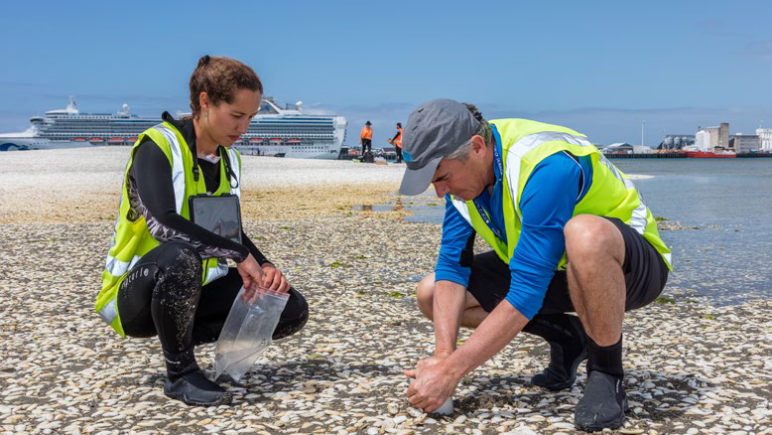
Environmental & sustainability
42

Slide 45
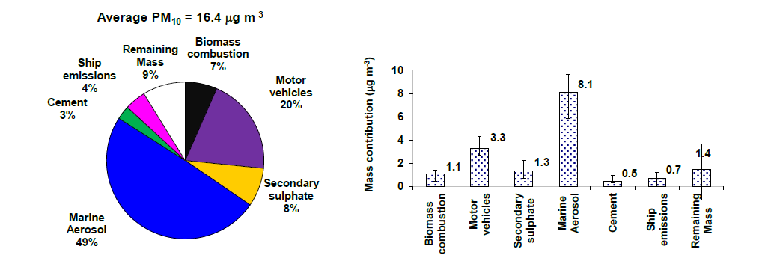
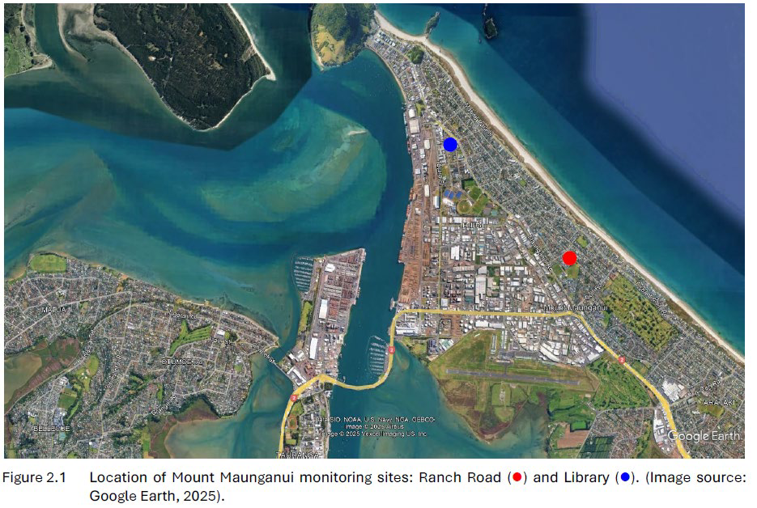
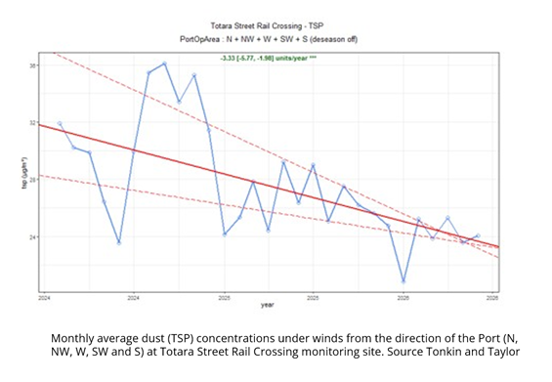
Mount Maunganui airshed
Air quality initiatives and improvements
Average source mass contributions to PM 10 at the Mount Maunganui Library site – Dec 2023 to Feb 2025
Monitoring sites – Mount Maunganui
Airborne dust source apportionment study has been completed. Further monitoring is ongoing.
Dust concentrations in the industrial area adjacent the Port activities continue to show improvement.
Source: Davy PK, Trompetter WJ. 2025 (Earth Sciences New Zealand)
43

Slide 46
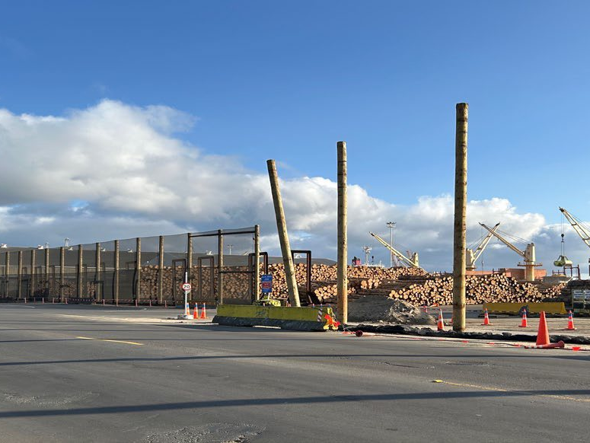
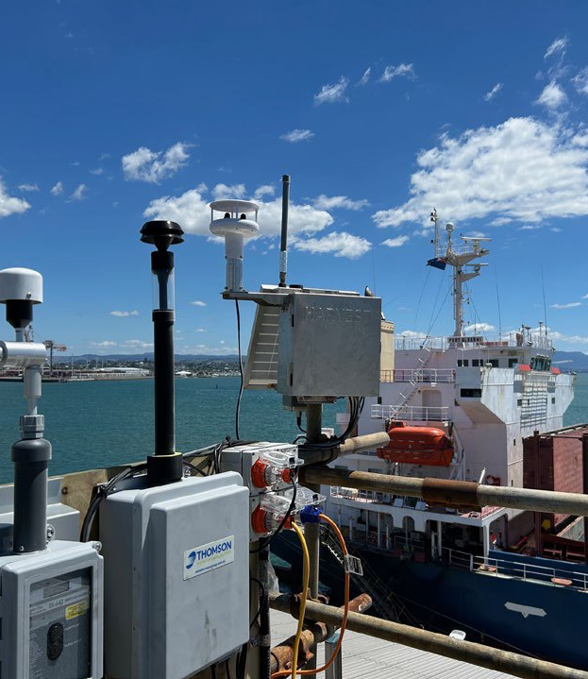
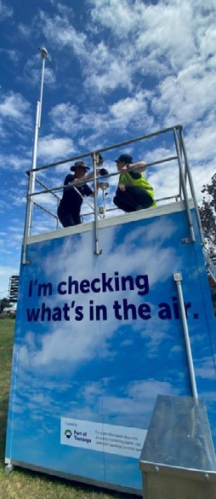
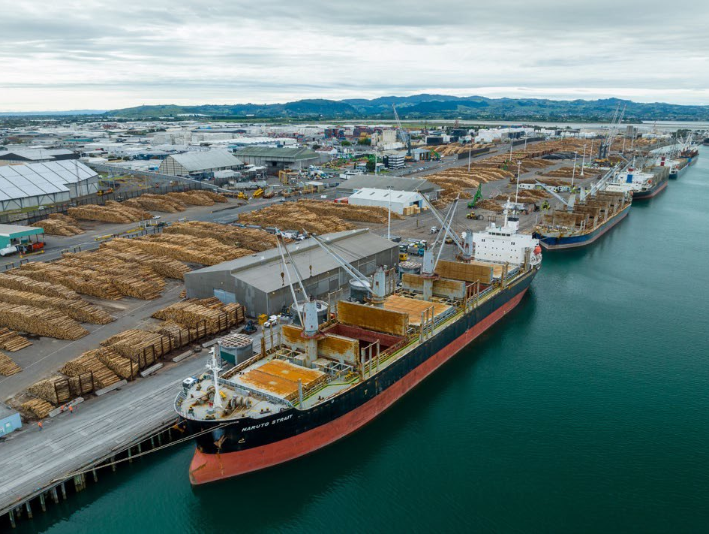
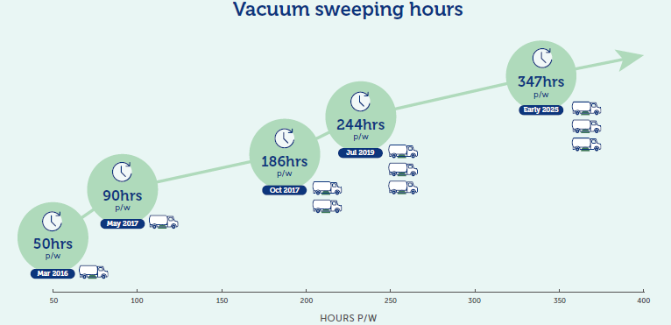
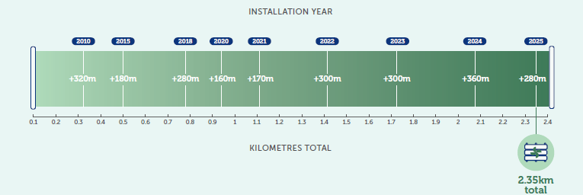
Dust control and monitoring
Air quality initiatives and improvements
Extensive wind fencing development in Mount Maunganui
Extensive dust and wind monitoring and alert network
NZ leading log yard housekeeping and cleaning programme
44

Slide 47
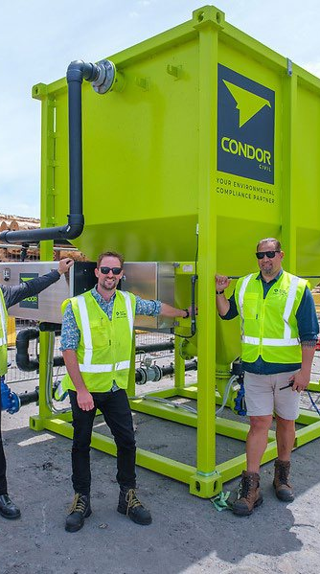
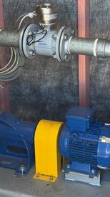
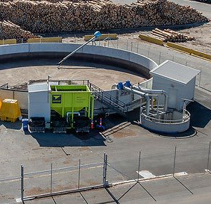
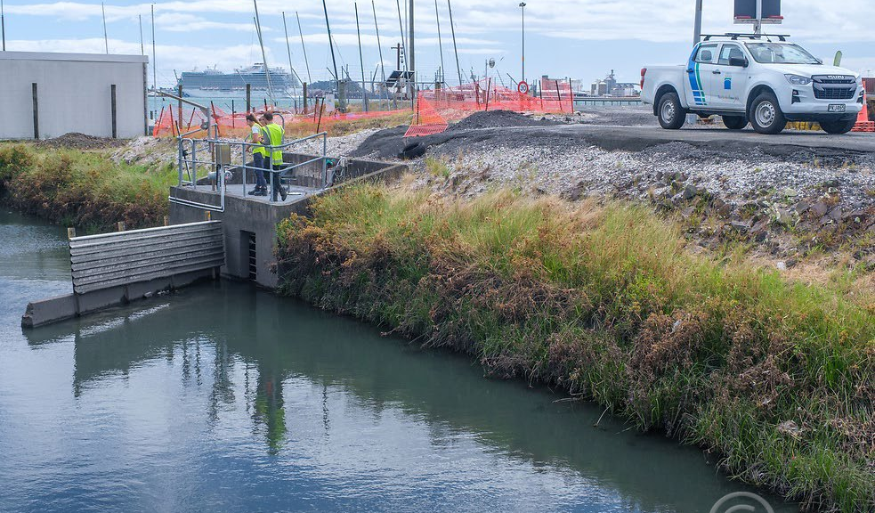
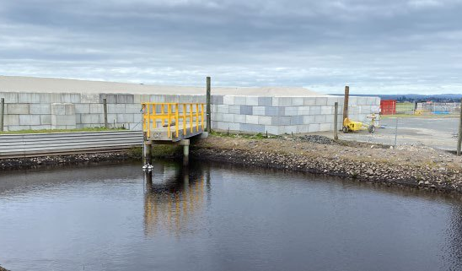
Stormwater
Water quality - stormwater
Sulphur Point stormwater treatment system
Investment in stormwater treatment
Stormwater settlement ponds and irrigation area – Hewletts Road log yard
New Mount wharves treatment system operational.
Comprehensive stormwater monitoring.
First-flush stormwater capture and treatment of up to 1 million litres.
Compliant and often well below stormwater quality limits.
Pumps can move over 300 litres per second!
45

Slide 48
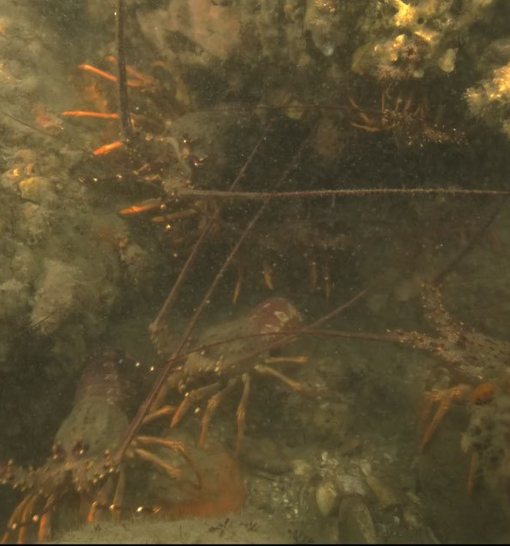
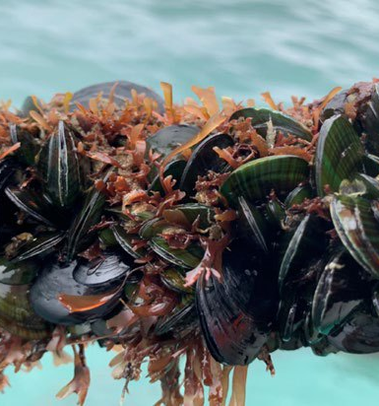
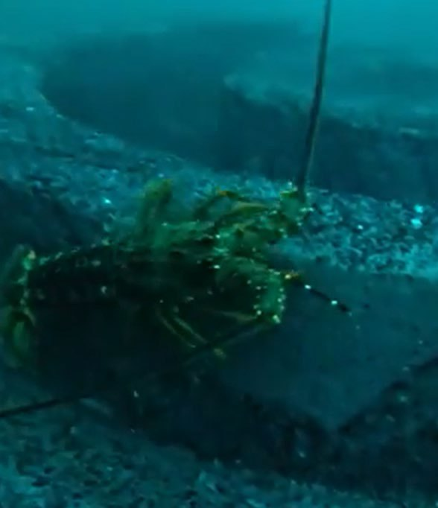
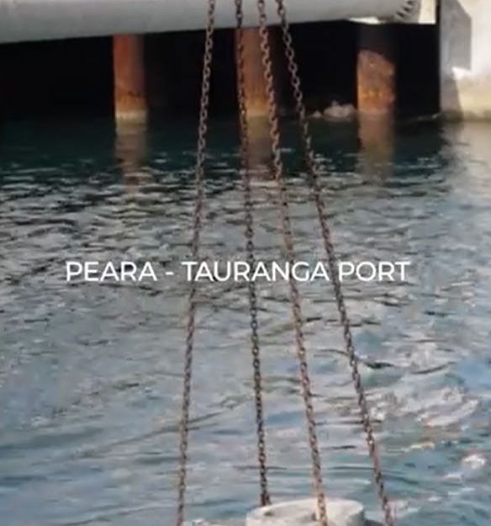

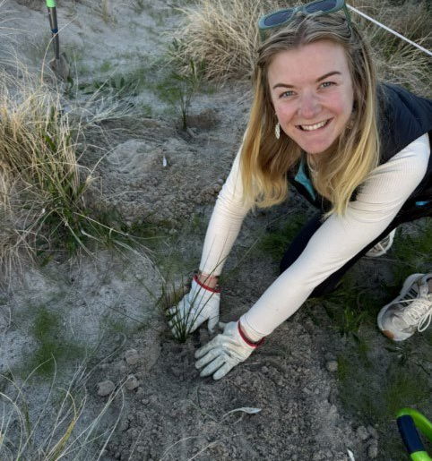
A continuous improvement approach
Harbour health – Te Awanui
2025 harbour surveys show positive results for condition of harbour.
Improving levels of marine life and biodiversity.
Working closely with Waikato University on future projects.
Port of Tauranga supports numerous harbour improvement initiatives such as artificial reef development, dune restoration bird protection.
46

